Slide 1

Model for Preventive Maintenance based on Predictive Analytics
BELLEVUE UNIVERSITY - DSC680 – Fall 2021 Rajkumar Kuppuswami

Slide 2
Business Understanding & Goal
Downtime for heavy machinery costs a lot of money in the manufacturing industry, both in terms of idle time wasted due to maintenance work and in terms of repair costs. It would be a significant boost to the bottom line if firms could be proactive and undertake routine maintenance activities proactively, as well as predict concerns ahead of time using previous data. Instead, enterprises typically use IOT (Internet of Things) sensors to monitor and collect data from a variety of telemetric sensors. A predictive model can be constructed by combining telemetry data and failure reports to anticipate future heavy machinery fault occurrences.
The ultimate goal is to develop a proactive maintenance plan that attempts to predict future component failure in heavy machinery. It benefits businesses by lowering operational costs, long-term maintenance costs, and increasing output hours, as previously stated.

Slide 3
Data Understanding
The following data sources were considered for building this Predictive Maintenance Model.
Telemetry : Time series data consisting of various measurements like - Voltage, Rotation, Pressure and Vibration readings from various machines.
Machines : Information about machines.
Failures : Records of failed components.
Maintenance : Maintenance historical records of machines involving component replacements due to regular maintenance activity or due to failures.
Errors : Historical errors thrown by the machines.

Slide 4
Exploratory Data Analysis
Telemetry data set has below variables:
datetime
machineID
volt
rotate
pressure
vibration
Machines:
machineID
model
age
Errors:
datetime
machineID
errorID
Maintenance:
datetime
machineID
Comp
Failures:
datetime
machineID
Failure
According to the business aim, the variable I'm attempting to predict is which component will fail; it might be any of the components - comp1, comp2, comp3, comp4, or none of them. The “Failure.csv” file contains the failure data's history.

Slide 5
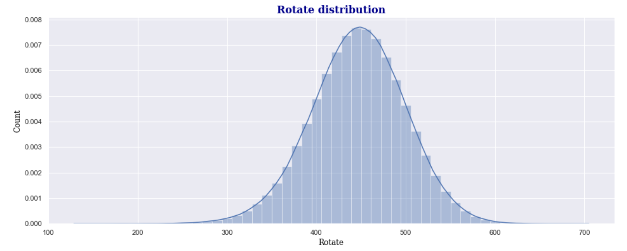
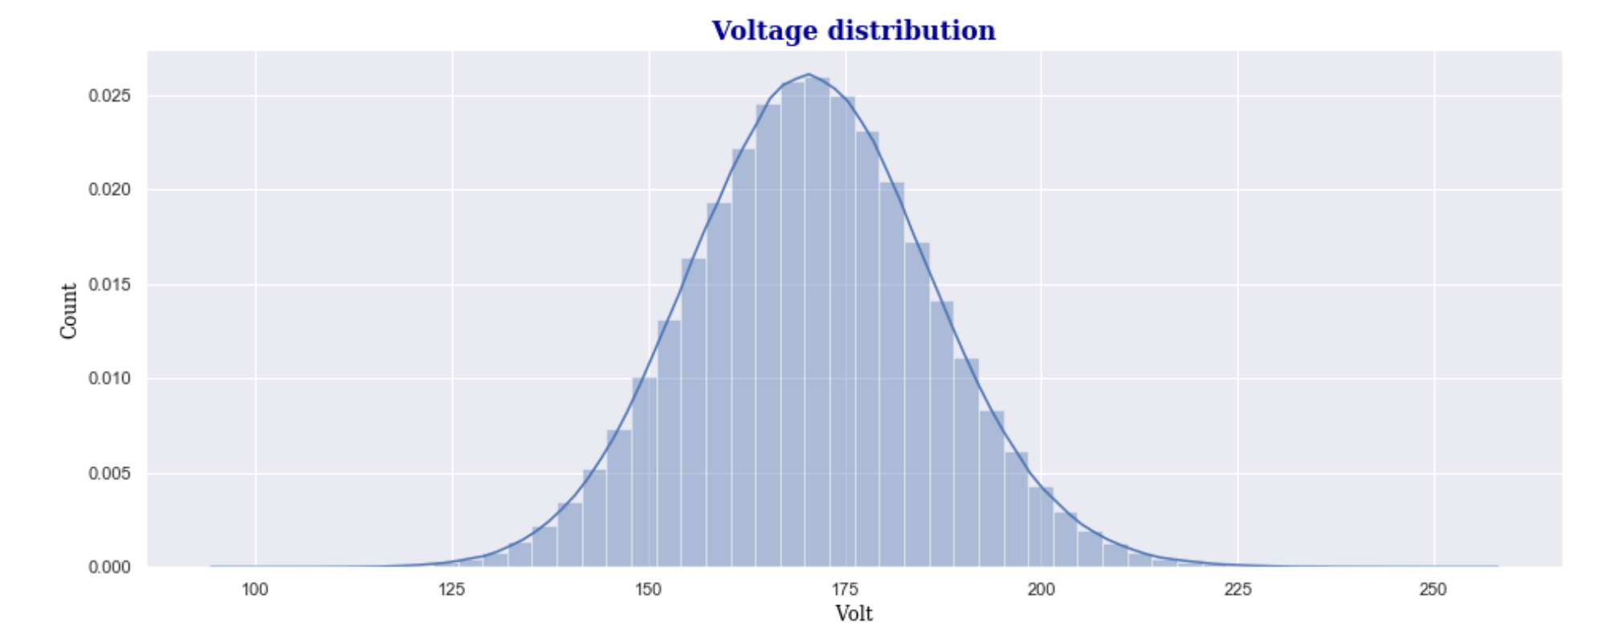
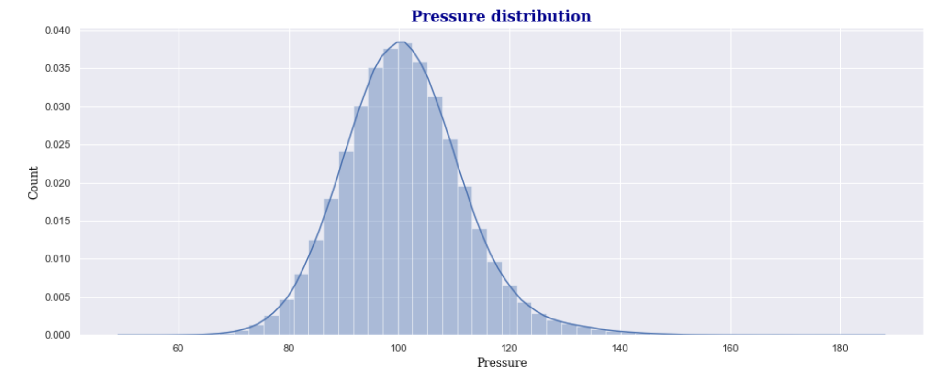
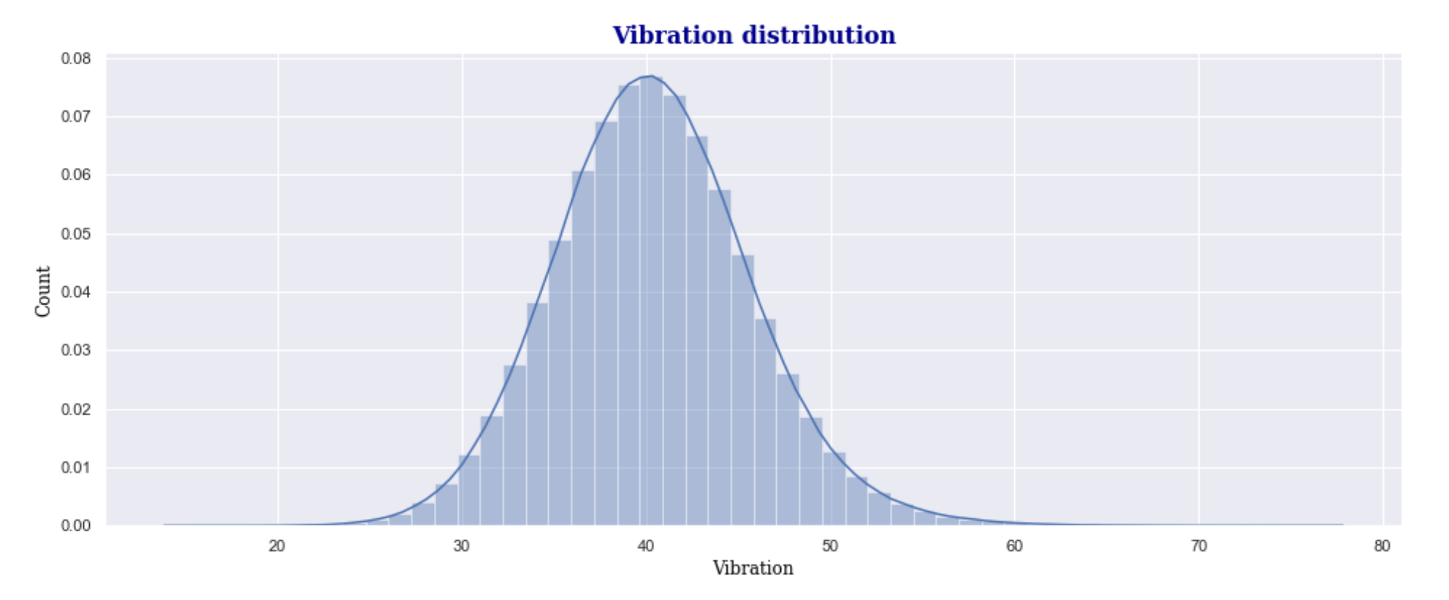

Slide 6

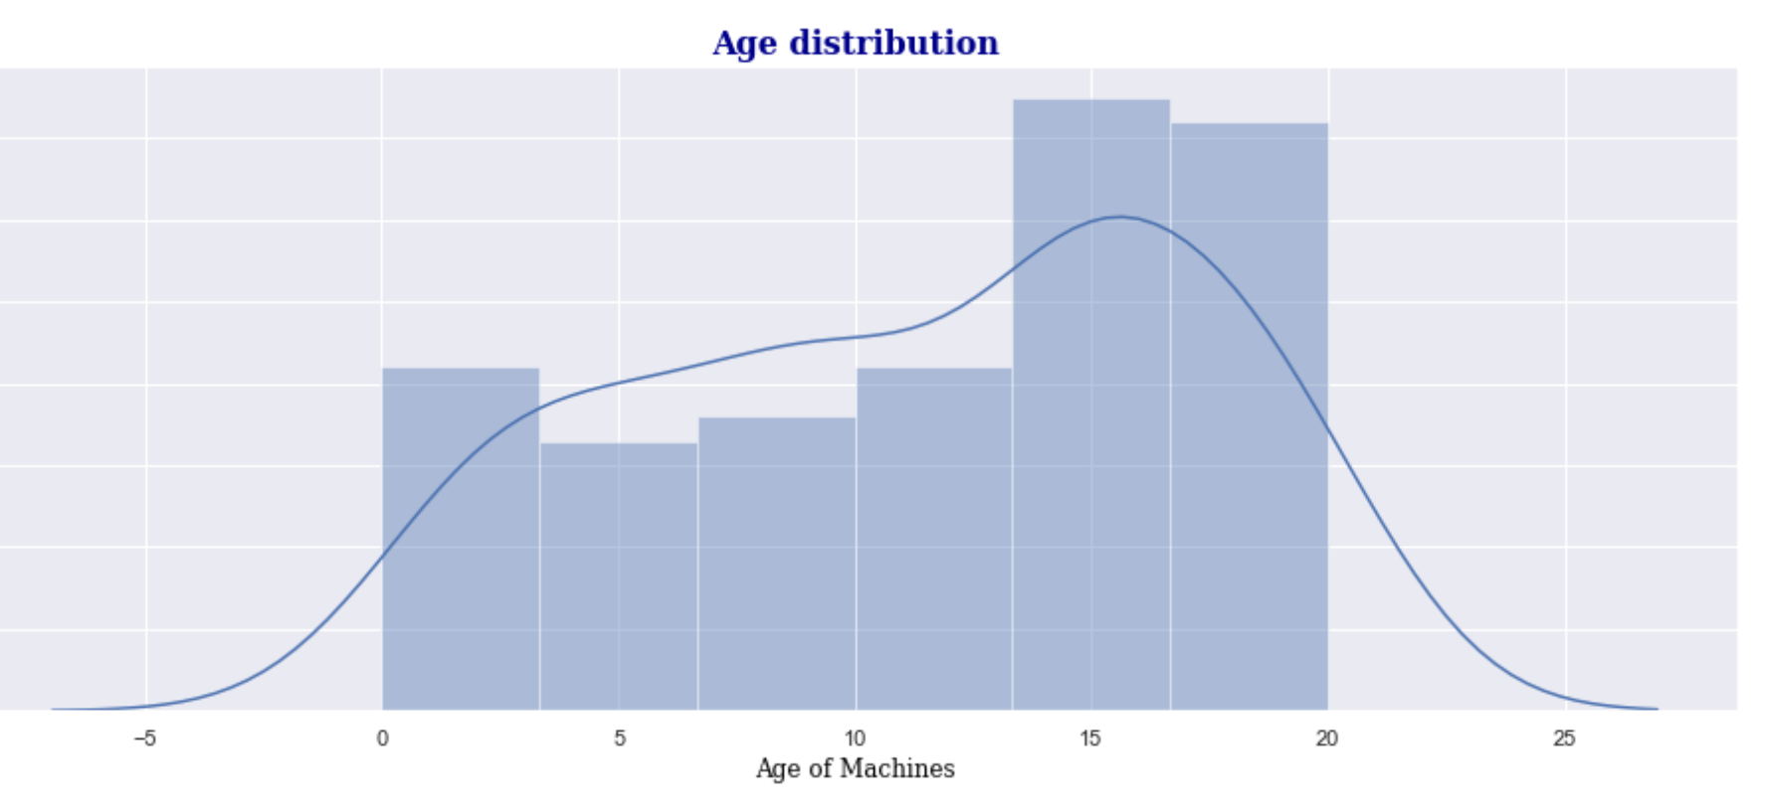
AGE Distribution

Slide 7
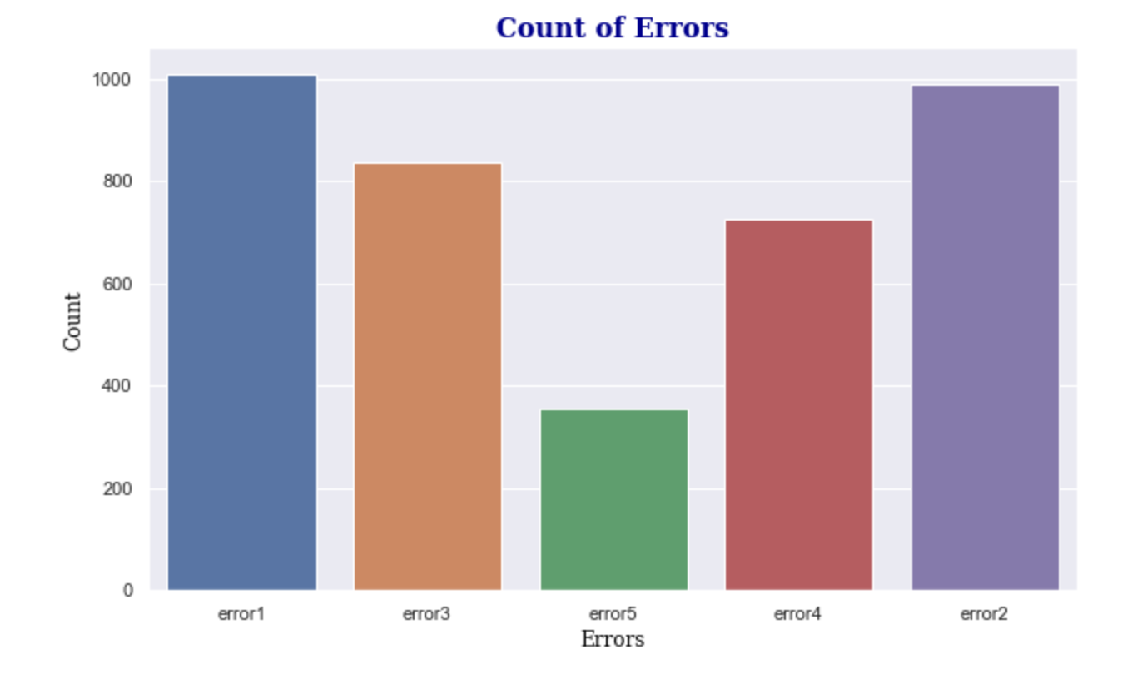
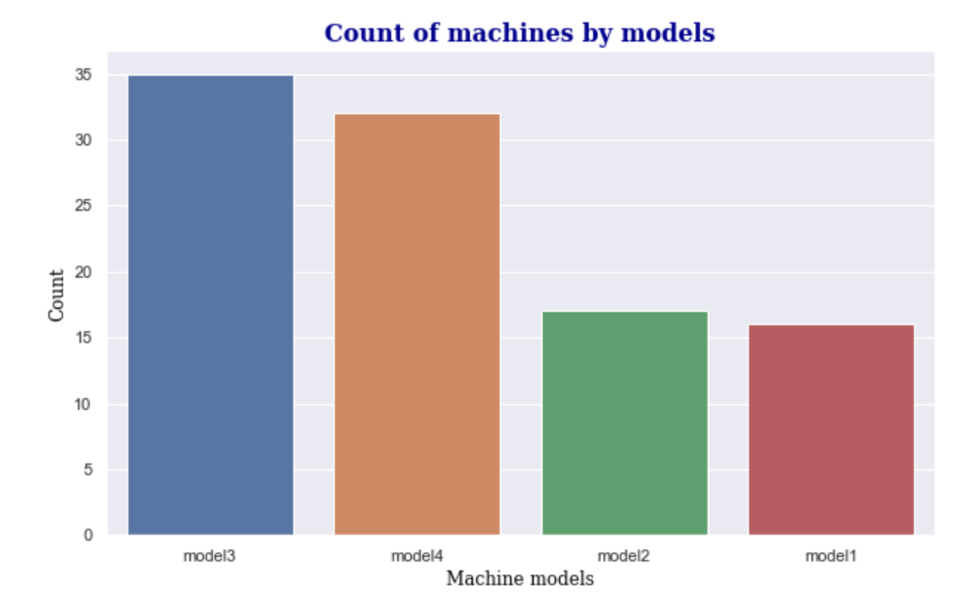
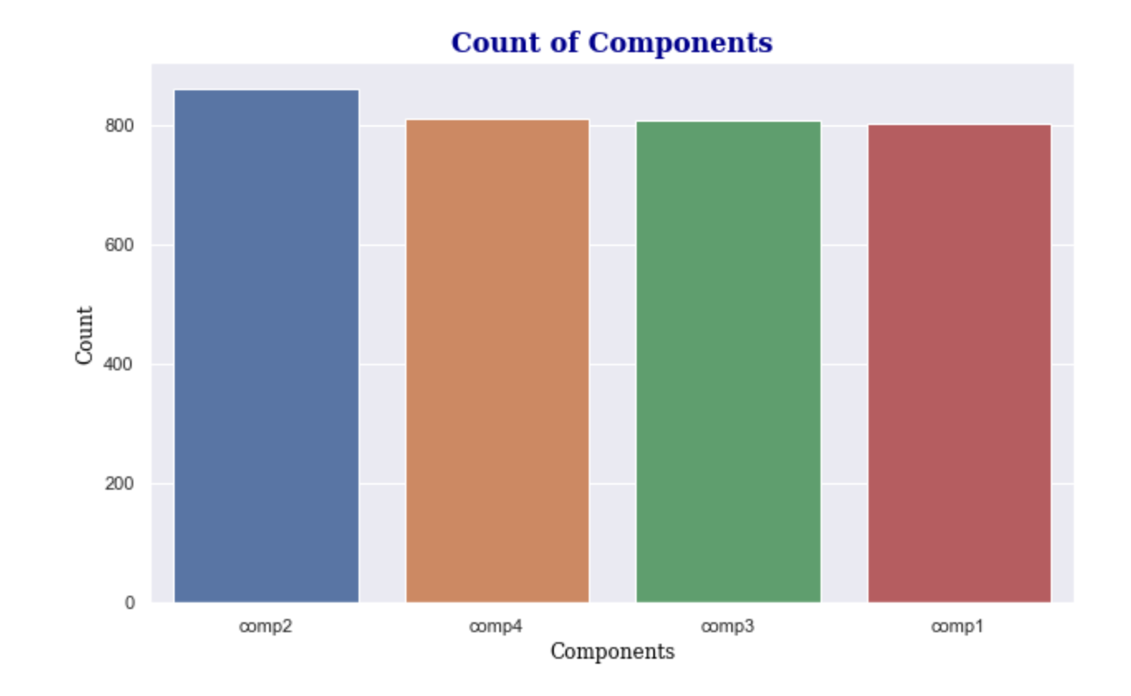
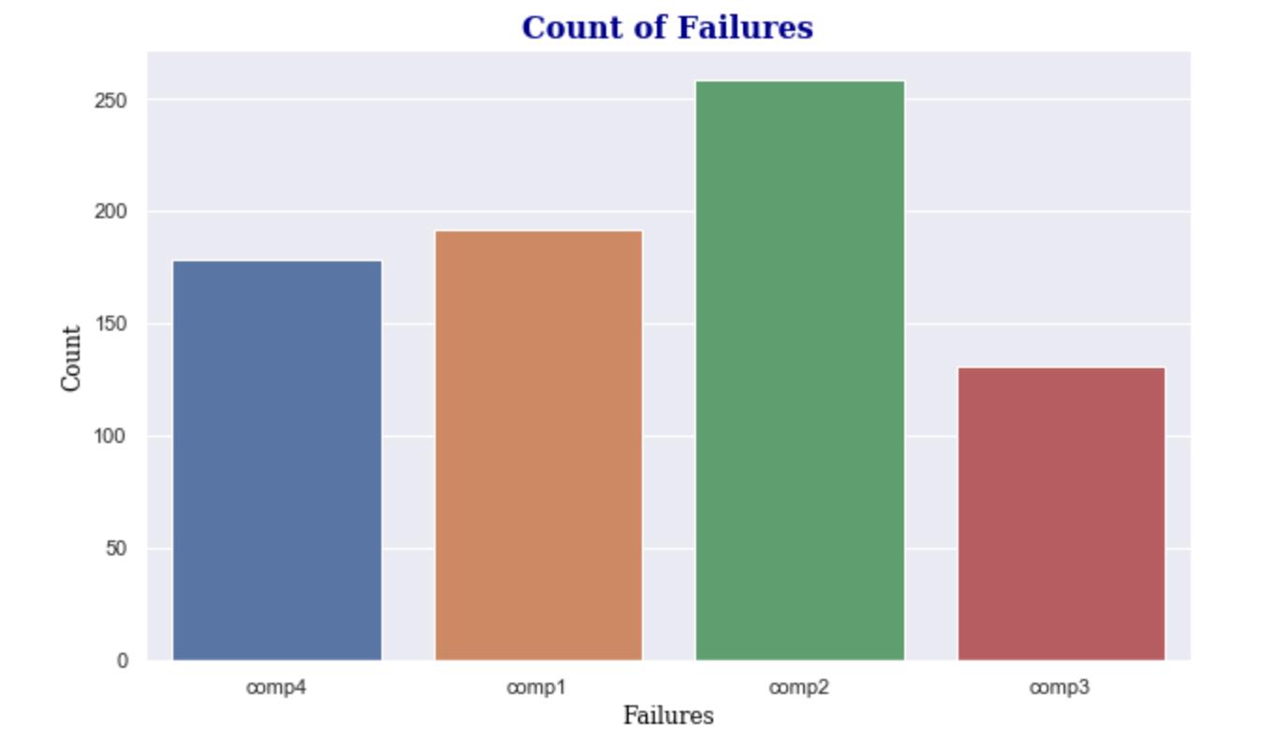
Counts

Slide 8
Model Tuning
Even though I achieved accuracy and recall rates of over 99 percent, I believe the model is slightly biased. The model can be improved further by considering the practicalities of generating various feature variables in preventive maintenance. To strengthen the model further, different types of classifying algorithms, such as Gradient Boosting Classifiers or Deep Neural Networks, can be applied.

Slide 9
Model Deployment
Create the model with best parameters obtained from tuning
Save the model using joblib module as a pickle
Deploy the pickle on the server and use it for fitting new unseen data

Slide 10
Conclusion
Performance of the model can be further improved upon using Deep Learning and Neural Networks

Slide 11
References
https://gallery.azure.ai/Experiment/Predictive-Maintenance-Implementation-Guide-Data-Sets-1
https://limblecmms.com/blog/predictive-maintenance/

Slide 12
Thank You

